Slide 1



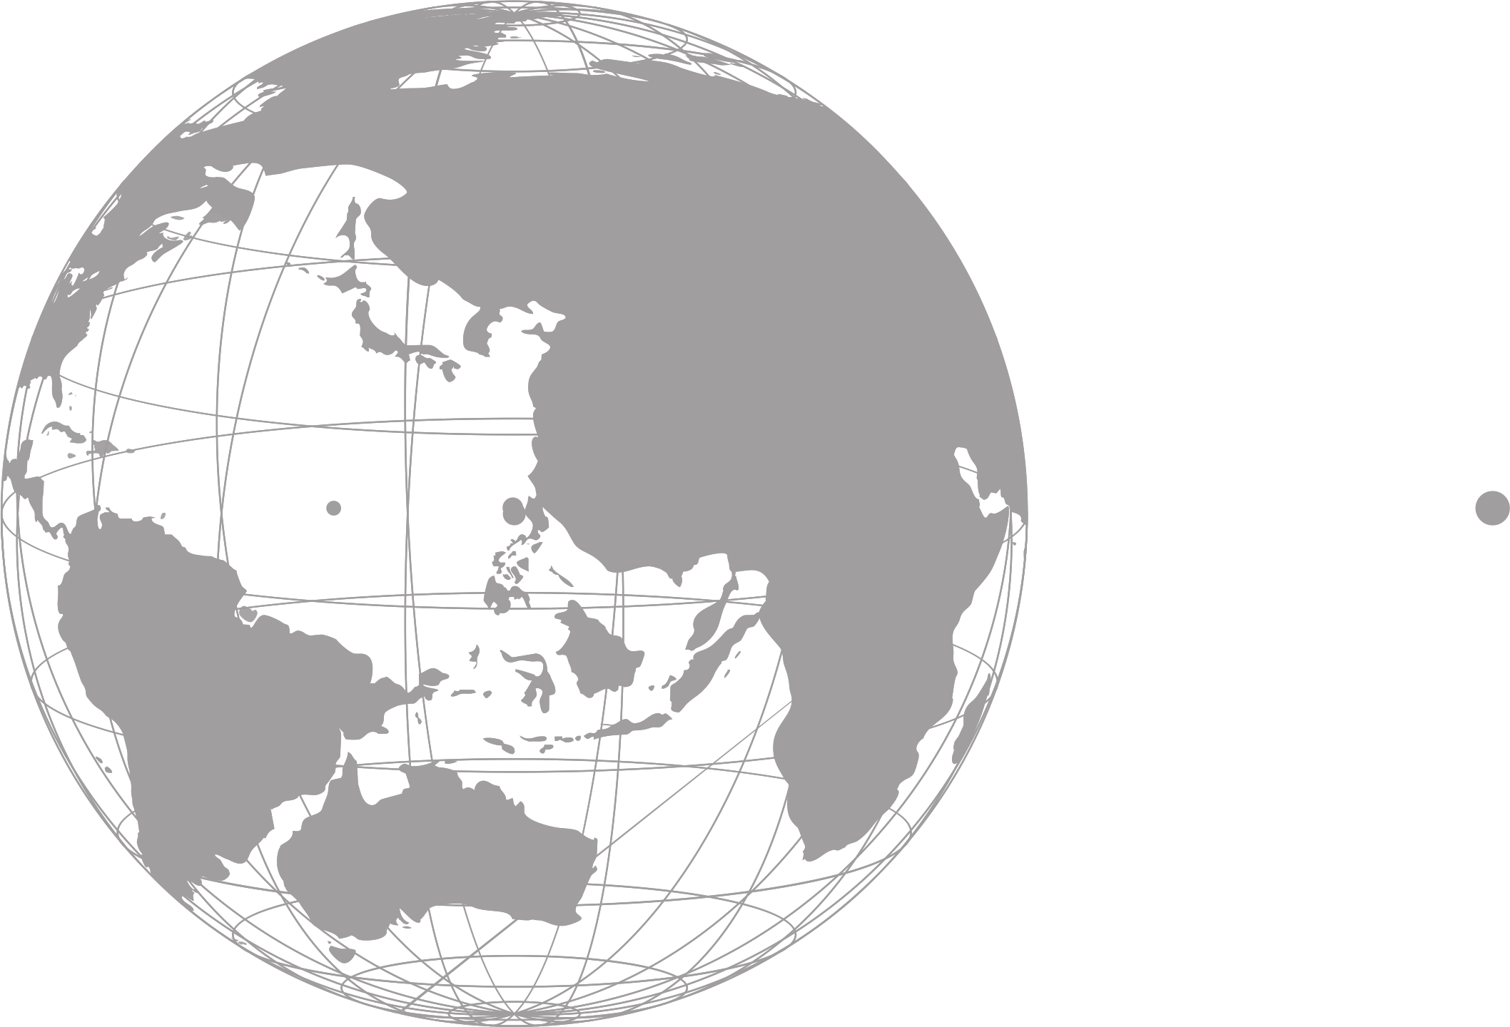
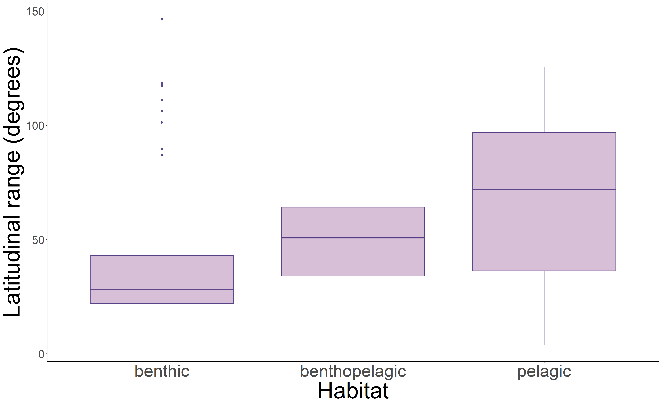
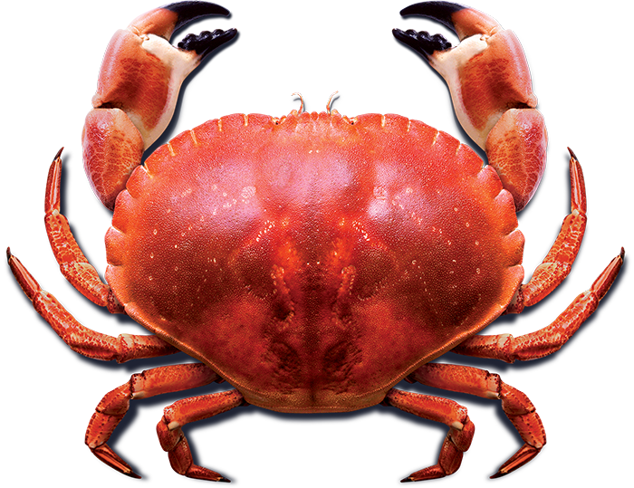
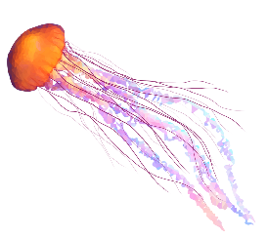
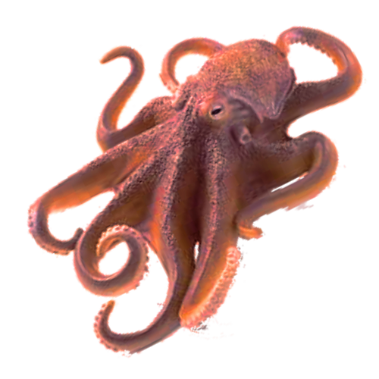
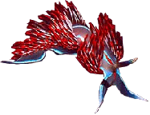

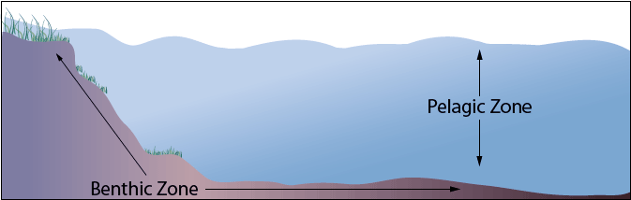
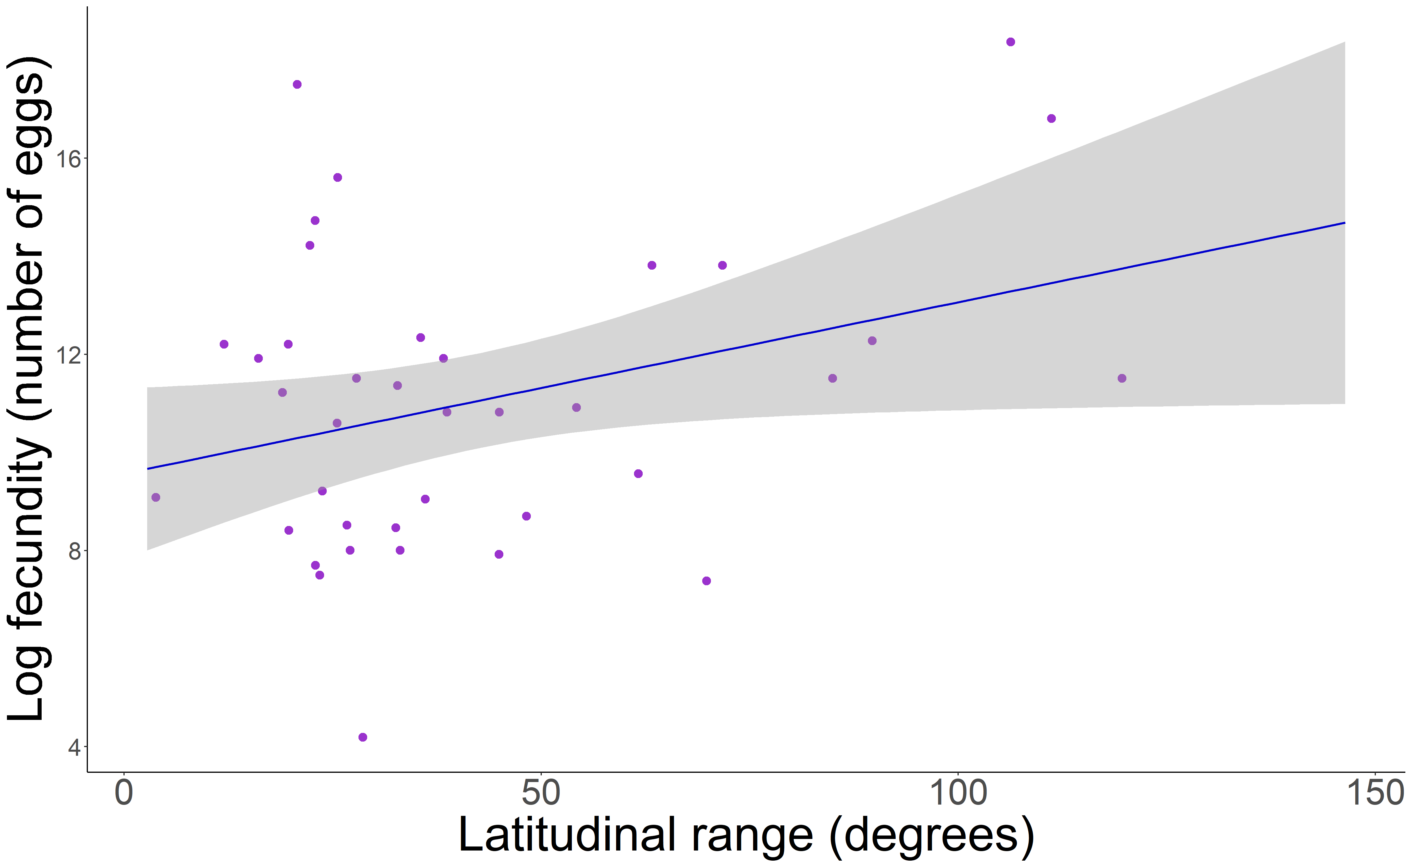
Impact of Temperature and Species Traits on Local Instances of Colonization and Extinction in North American Marine Invertebrates
Cassiel E. Padilla-Durán*, Zoë Kitchel, Malin L. Pinsky
Department of Ecology, Evolution and Natural Resources
Rutgers, The State University of New Jersey
*cassiel.padilla@upr.edu
Introduction
Results
Discussion
Climate change
Figure 1. Correlation between latitudinal range and habitat (p=0.003)
Invertebrates with high latitudinal ranges tend to:
Inhabit the pelagic zone
Lay a large number of eggs
*
Species expand latitudinal range
Which may lead to
97% of animals on earth are invertebrates
Larger range shifts
Our study focuses on North American marine invertebrates
Higher propensity to colonize an area
High range shifts
Figure 2. Diagram of benthic and pelagic zones
Future directions
Species traits may be used to explain these shifts and predict colonization or extinction in a particular area
Objectives
Temperature
+
Species traits
Make data on marine invertebrates more accessible
Figure 3. Positive correlation between fecundity and latitudinal range (p=0.04)
Better the understanding of how species traits interact with each other in North American marine invertebrates
Methods
Colonization?
Extinction?
Compile trait data on 154 North American marine invertebrates
Traits: Maximum and average length/weight/width, fecundity, larval development, habitat, latitudinal range, northern range boundary, southern range boundary
Acknowledgements
I would like to thank my mentors Zoë Kitchel and Dr. Malin Pinsky for their guidance, everyone in the Pinsky lab for being open and welcoming, RISE at Rutgers for giving me the opportunity to participate in this summer research experience, and the NJ Space Grant Consortium for their support.
Data analysis on R programming software
Linear regression, ANOVA, Tukey’s HSD test

